Slide 1

Linked Data and the Semantic Web: the Basics
Pieter Pauwels
LDAC Summer School
17 June 2019

Slide 2
Outline
Information exchange and the AEC industry
LBD in practice!
Some technical basics
Scaling up the graph
Exercises

Slide 3
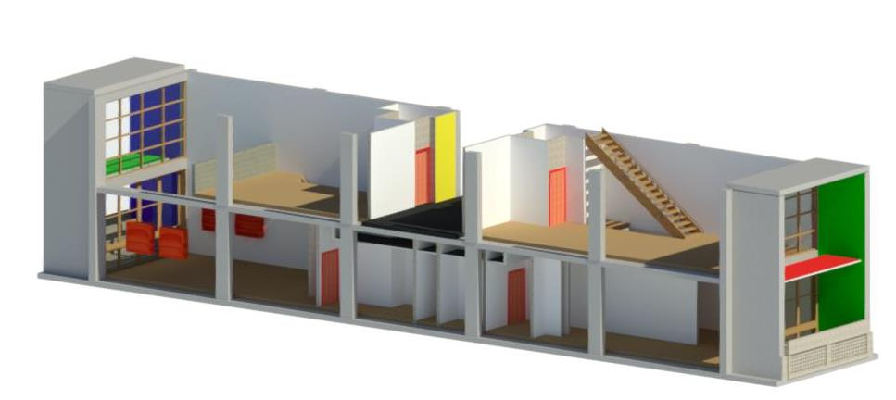
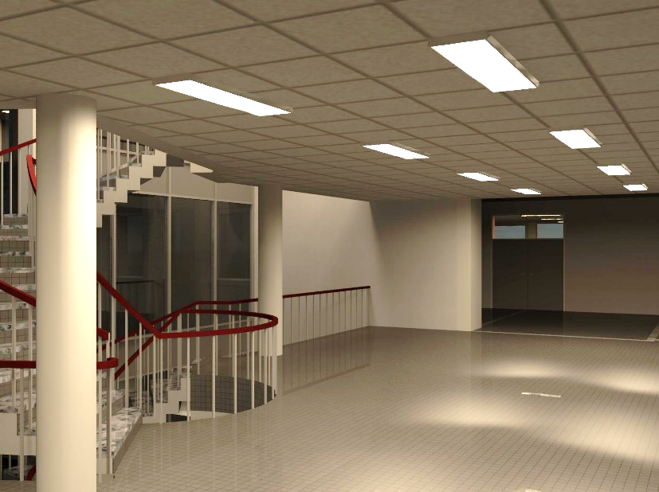
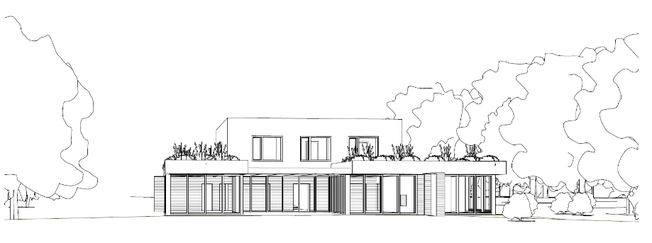
Building Information Modelling

Slide 4
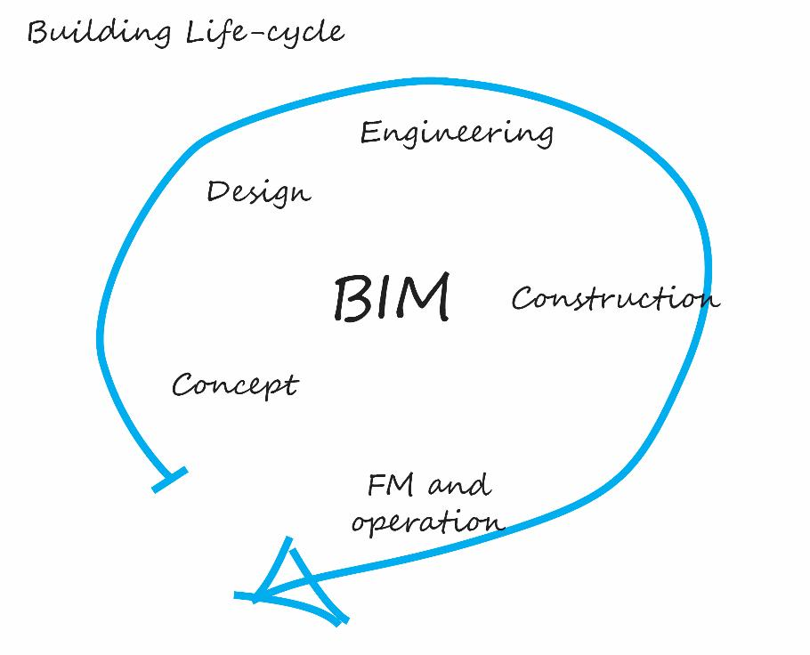

Slide 5
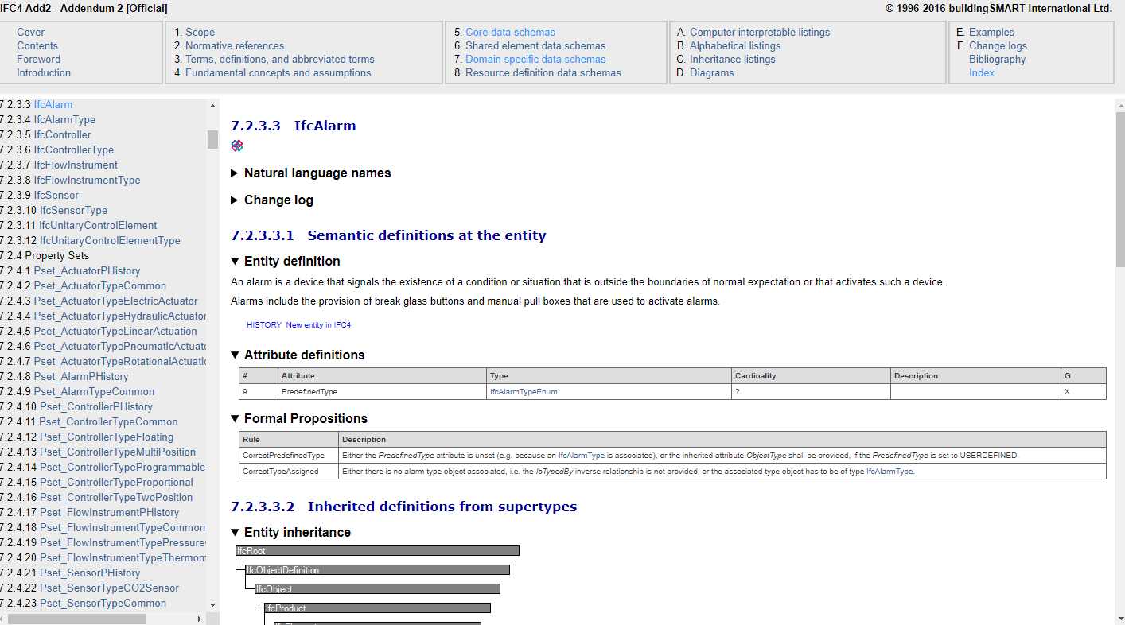

Slide 6
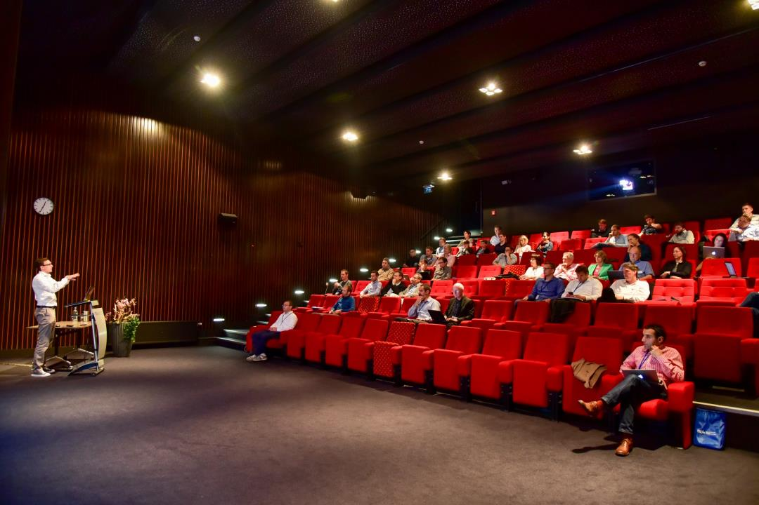
http://www.buildingsmart-tech.org/ future/linked-data/

Slide 7
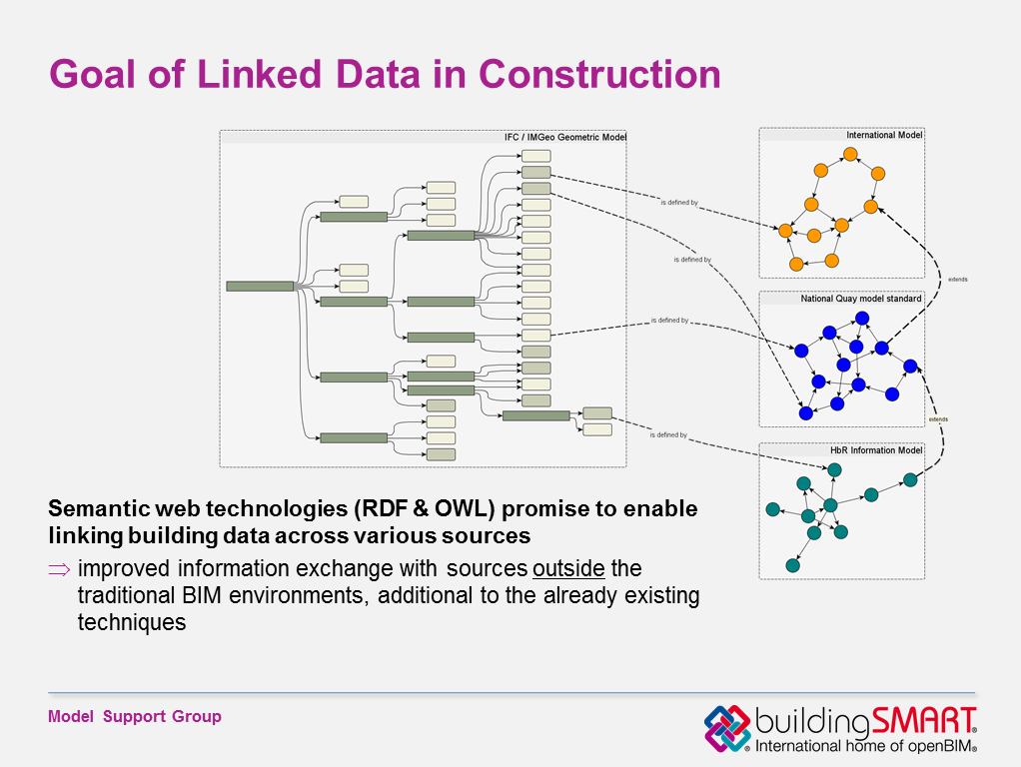
Toronto Oct. 2014 T. Liebich
INFRA
IFC
SENSOR
GIS
Image courtesy: Jakob Beetz, TU Eindhoven

Slide 8
Different serializations of the same data model
IFC-SPF
EXPRESS
XML
XSD
RDF
ifcOWL

Slide 9
ifcOWL ontologies available
Ifc2x_all_lf.exp
IFC2X2_ADD1.exp
IFC2X2_FINAL.exp
IFC2X2_PLATFORM.exp
IFC2X3_Final.exp
IFC2X3_TC1.exp
IFC4.exp
IFC4_ADD1.exp
not supported
not supported
not supported
not supported
IFC2X3_Final.owl / .ttl
IFC2X3_TC1.owl / .ttl
IFC4.owl / .ttl
IFC4_ADD1.owl / .ttl
http://ifcowl.openbimstandards.org/IFC4_ADD1
http://ifcowl.openbimstandards.org/IFC4
http://ifcowl.openbimstandards.org/IFC2X3_Final
http://ifcowl.openbimstandards.org/IFC2X3_TC1

Slide 10
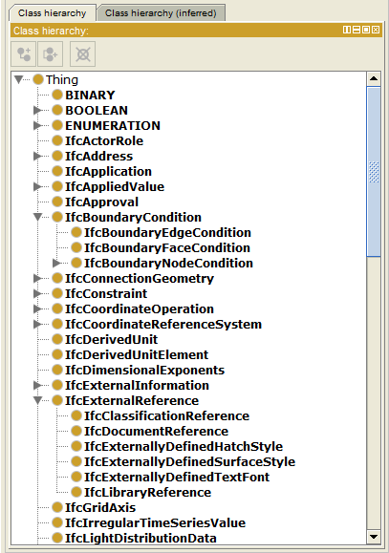
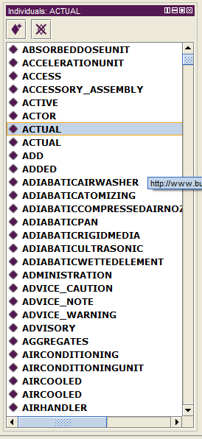
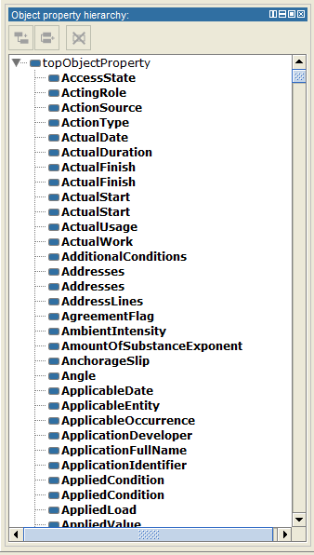
CLASSES
INDIVIDUALS
OJECT PROPERTIES

Slide 11
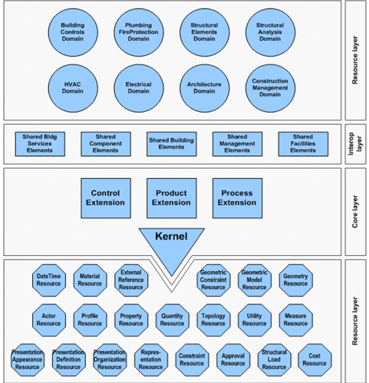
Industry Foundation Classes (IFC)
There exists a standard, but:
not modular
not extensible
not simple enough to use
AND not Web-compliant !

Slide 12
Outline
Information exchange and the AEC industry
LBD in practice!
Some technical basics
Scaling up the graph
Exercises

Slide 13
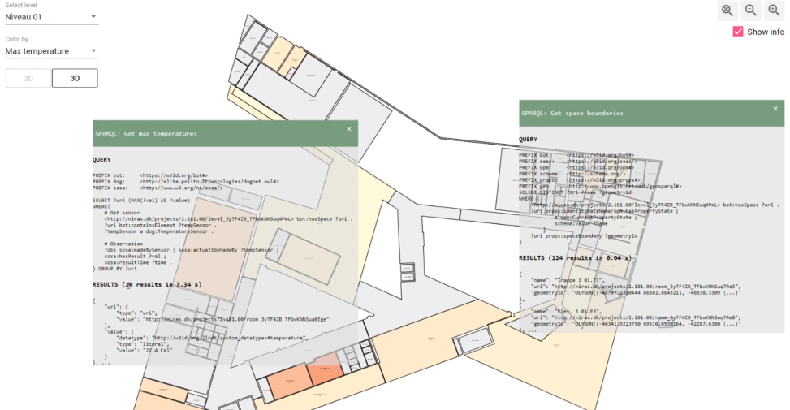
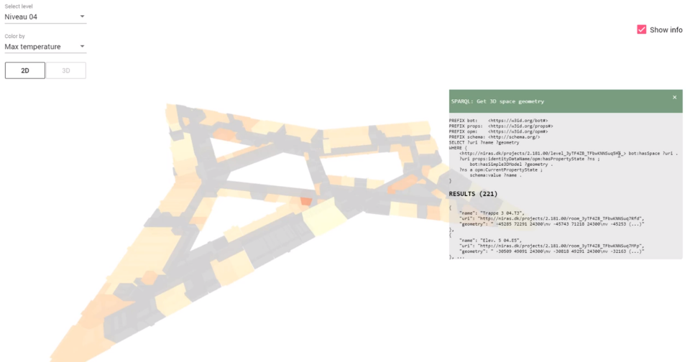
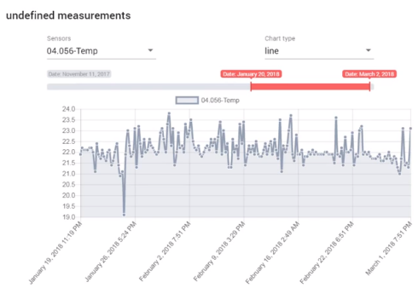
BOT + SOSA + geometry

Slide 14
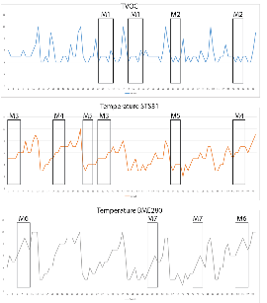
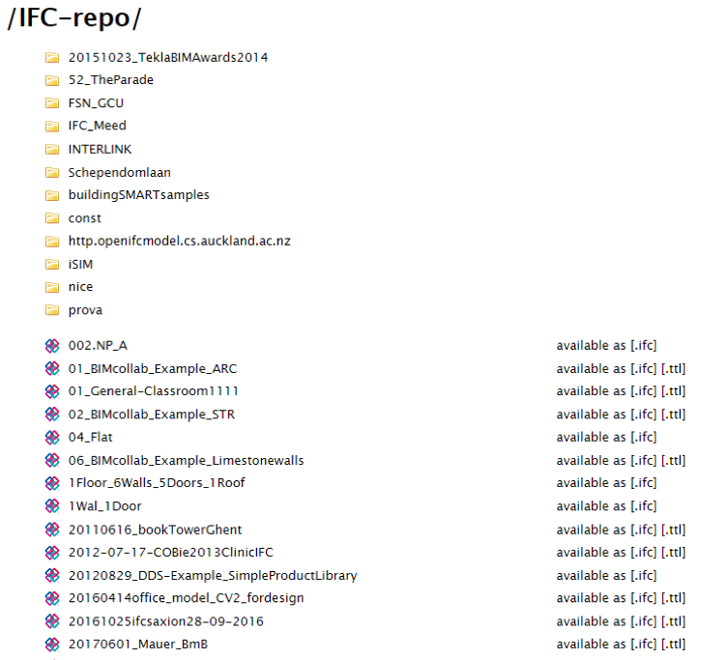
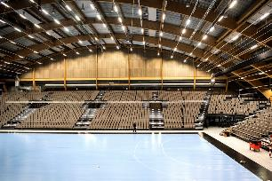

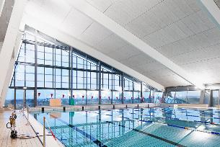
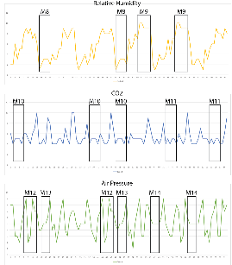

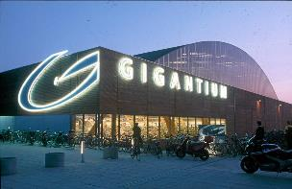
Implementation @Gigantium Denmark - Combination with sensor data
Repo of 531 LBD building graphs
36 million triples in total
372 bot:Building instances
3,523 bot:Zone instances
2,117 bot:Space instances
615,452 bot:Element instances
converted from http://smartlab1.elis.ugent.be:8889/IFC-repo/
to LBD using https://github.com/jyrkioraskari/IFCtoLBD

Slide 15
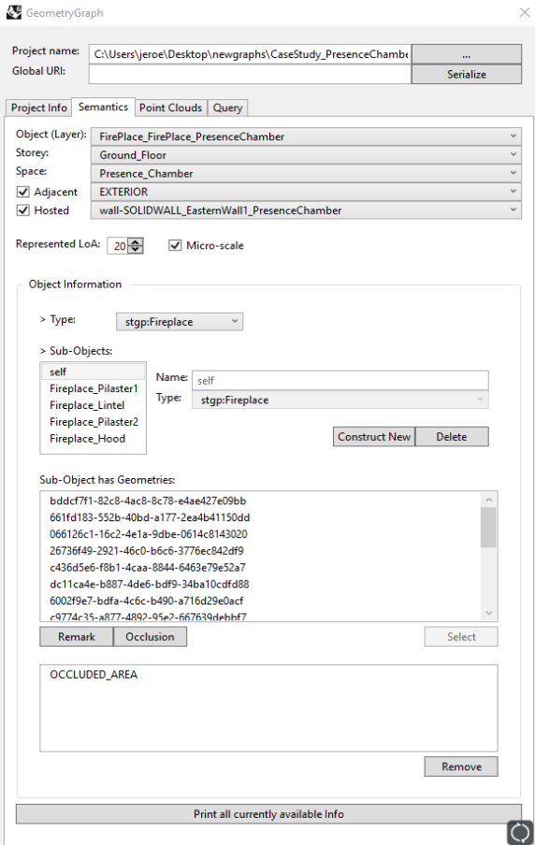
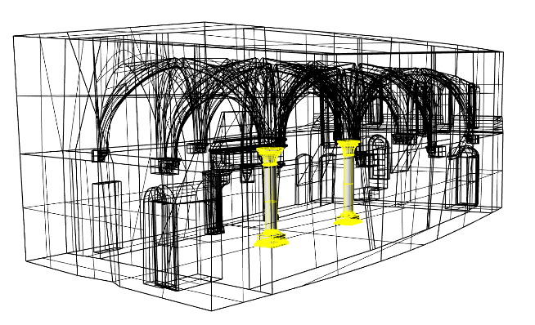
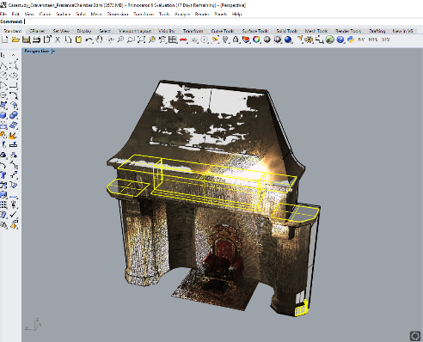
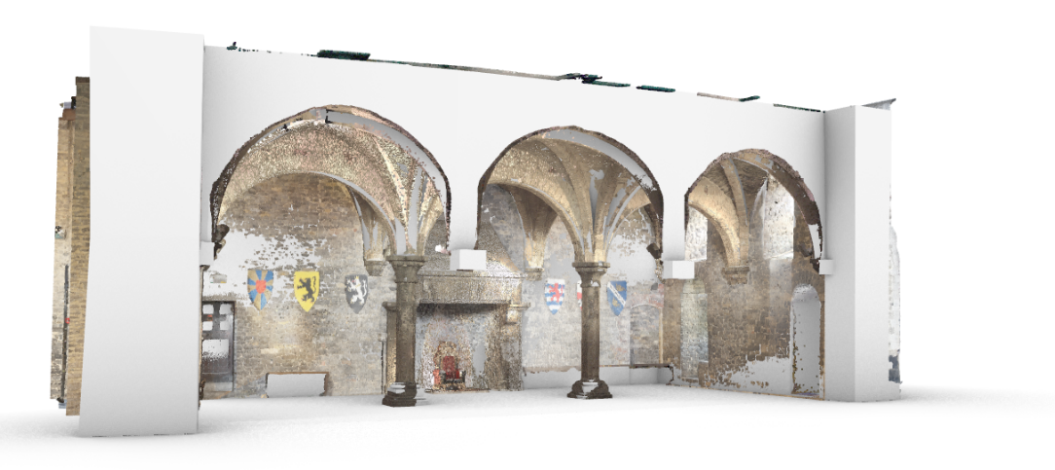
Scan to LBD Graph

Slide 16
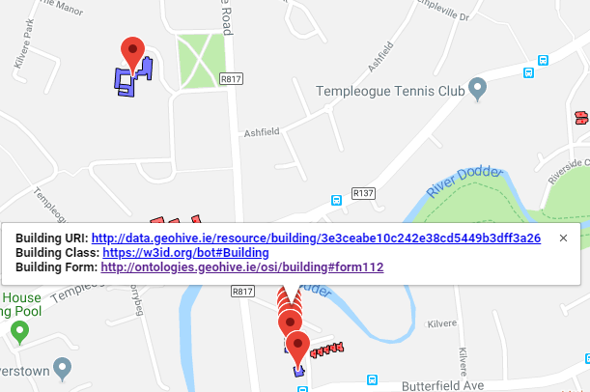
BOT and geospatial data
Using BOT to interlink Ordnace Survey Ireland building data (>3.5 million buildings)
Provide a registry of authoratative URI’s for Irish building stock.
http://geovis.adaptcentre.ie/
Username: odef_adapt
Password: geo123

Slide 17
Outline
Information exchange and the AEC industry
LBD in practice!
Some technical basics
Scaling up the graph
Exercises

Slide 18
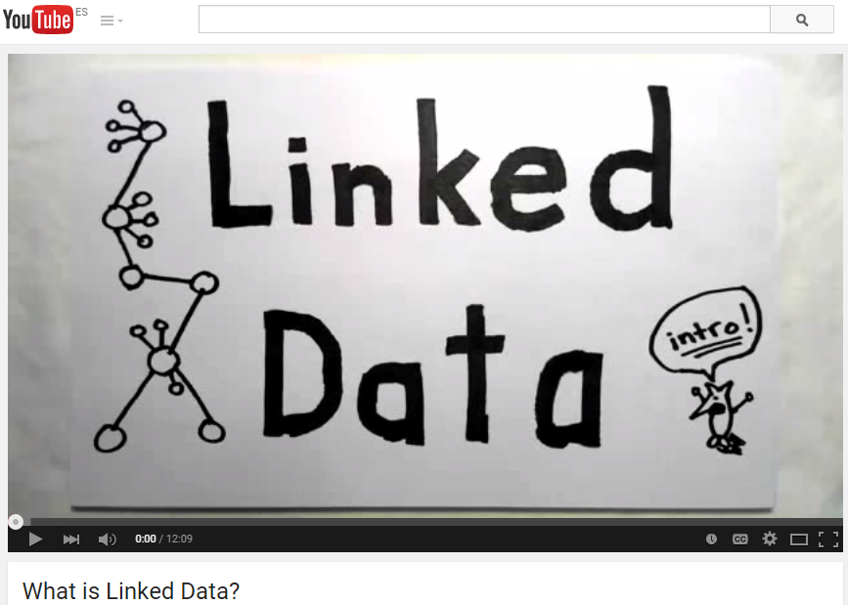
The cool and awesome intro movies
https://vimeo.com/36752317
https://www.youtube.com/watch?v=4x_xzT5eF5Q
https://www.youtube.com/watch?v=OM6XIICm_qo
Notes:
ask them about the ways in which they currently handle data in their specific job descriptions (as I also do in our Ghent BIM course).

Slide 19


Slide 20
Resource Description Framework
RDF stands for Resource Description Framework
RDF is a standard data model for describing web resources
Note: ‘web resources’ can make statements about anything in the real world: DBPedia, geography, building information, sensors, … anything goes
RDF is designed to be read and understood by computers
RDF is not designed for being displayed to people
RDF is written in XML
RDF is a W3C Recommendation
easily used
not a file format, not a syntax, not a schema, … => a data model
usually
-> standardisation
http://www.w3schools.com/webservices/ws_rdf_intro.asp

Slide 21
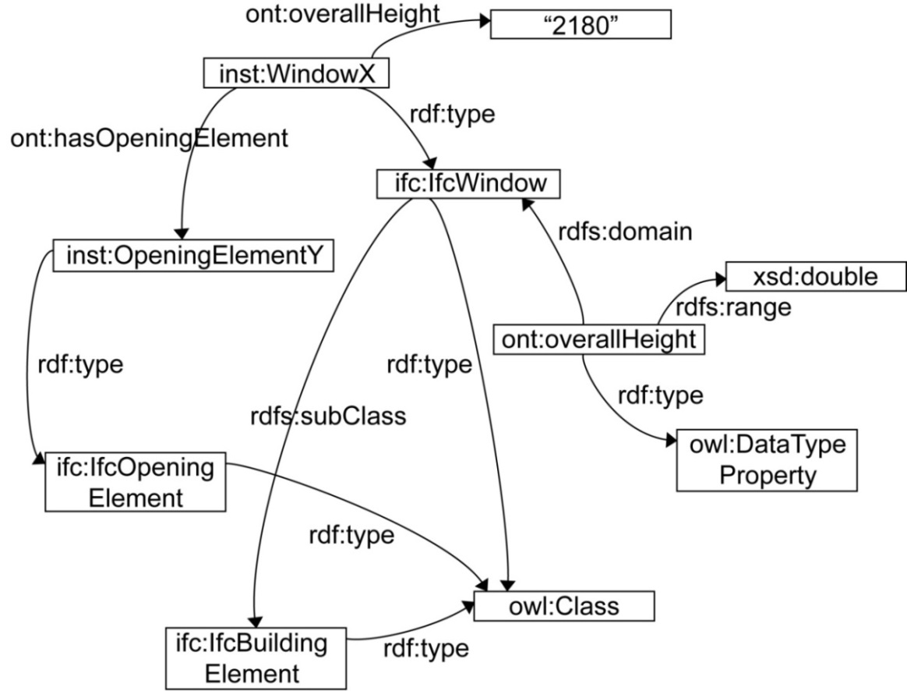
RDF Graphs, what are they?
LABELLED
DIRECTED
Triple

Slide 22
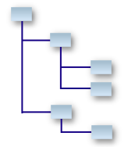
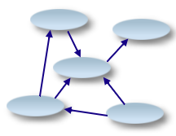
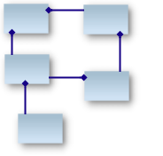
RDF Graphs, what are they not?
Hierarchies (cfr. XML)
RDF graphs are DIRECTED, LABELLED GRAPHS
Relational databases (cfr. SQL)

Slide 23
Connecting Triples
OBJECT
PREDICATE
OBJECT
PREDICATE
OBJECT
PREDICATE
PREDICATE
SUBJECT
OBJECT

Slide 24
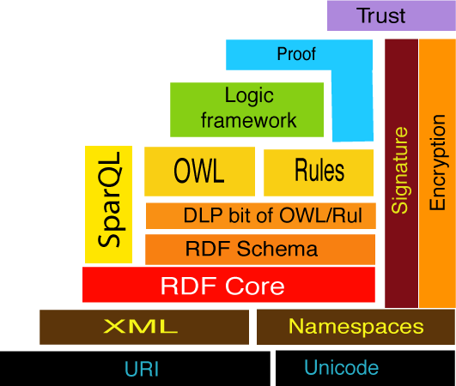
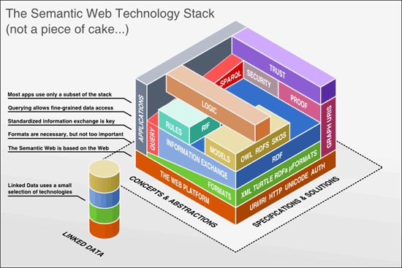
Tim Berners-Lee. WWW past & future, 2003. http://www.w3.org/2003/Talks/0922-rsoc-tbl/.

Slide 25
Example RDF graph
@prefix b: <http://www.beta-i.com/building#> .
@prefix c: <http://www.beta-i.com/city#> .
<http://www.beta-i.com/today#building_1>
b:hasRoom <http://www.beta-i.com/today#room_1> ;
b:hasName “Our course building";
c:partOfCity <http://cities.com/#lisbon> .
<http://cities.com/#lisbon>
c:closeToCity <http://cities.com/#cascais> ;
c:hasName “Lisbon” .

Slide 26
Example RDF graph
b:hasRoom
Room_1
Building_1
“Our course building”
b:hasName
c:closeToCity
cascais
c:partOfCity
lisbon
c:hasName
“Lisbon”

Slide 27
URI
URI
b:hasRoom
Room_1
URI
Building_1
URI
“Our course building”
b:hasName
URI
c:closeToCity
cascais
URI
URI
URI
c:partOfCity
lisbon
URI
“Lisbon”
c:hasName

Slide 28
Uniform Resource Identifiers (URIs)
URI stands for Uniform Resource Identifier
Purpose: Obtain globally unique identifiers, so that information can be exchanged globally.
Structure:
<http://www.beta-i.com/today#building_1>
Namespace
Name

Slide 29
Outline
Information exchange and the AEC industry
LBD in practice!
Some technical basics
Scaling up the graph
Exercises

Slide 30

Data integration now possible
MyBuilding
Cities

Slide 31
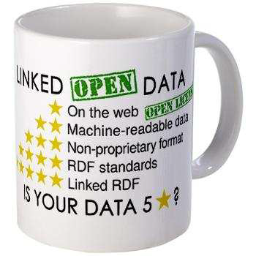
Main principles
distributed / decentralised information management
interactive information search and reasoning over the web
sharing partial data

Slide 32
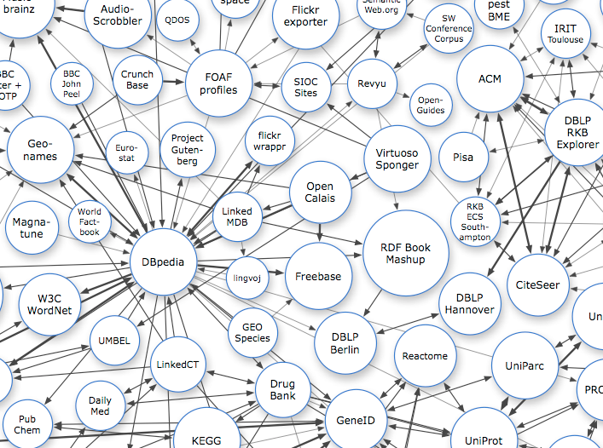
Linked Open Data cloud (LOD)
http://tomheath.com/blog/2009/03/linked-data-web-of-data-semantic-web-wtf/

Slide 33
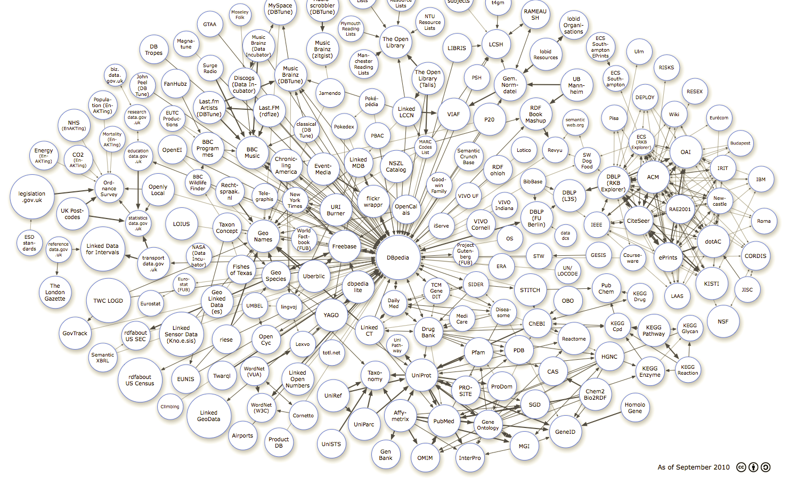
Bring BIM into the Semantic Web
BIM

Slide 34
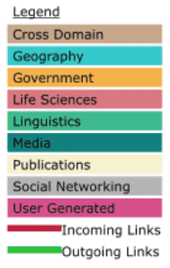
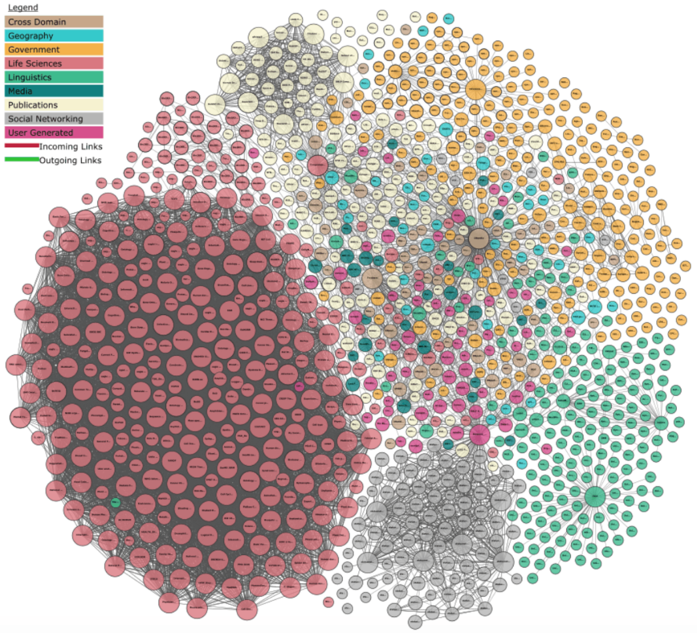
LOD cloud grouped per domain
https://lod-cloud.net/
https://lod-cloud.net/

Slide 35
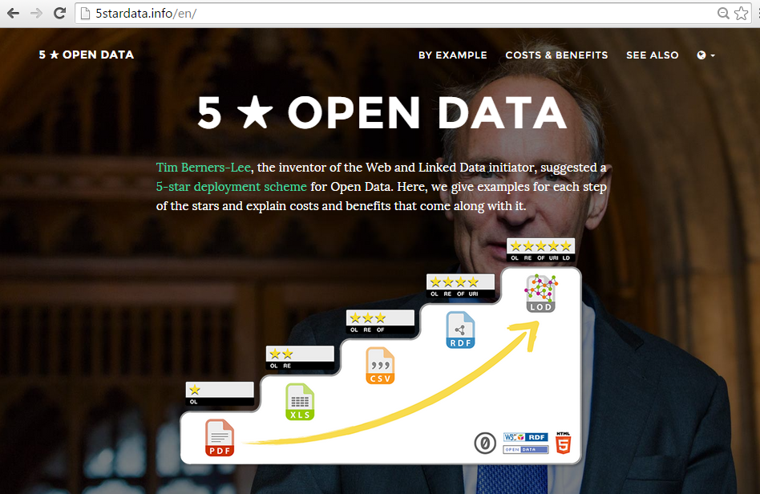

Slide 36
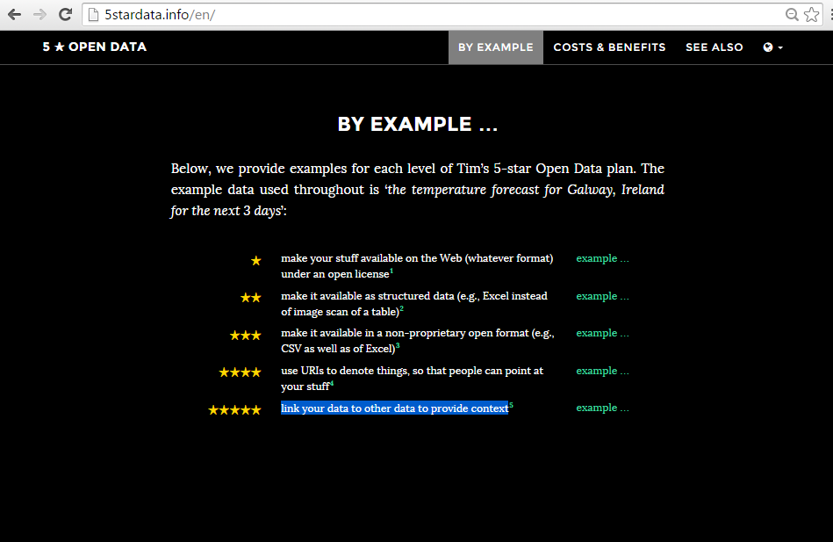

Slide 37
What else?
Ontologies
An ontology is a formal, explicit specification of a shared conceptualization
Abstract model and simplified view of some phenomenon in the world that we want to represent
Machine-readable
Concepts, properties, relations, functions, constraints, axioms
Consensual knowledge
R. Studer, V.R. Benjamins, D. Fensel. Knowledge engineering: Principles and methods. Data & Knowledge Engineering 25(1-2): 1998. 161-197. T.R. Gruber. A translation approach to portable ontology specifications. Knowledge Acquisition 5(2): 1993. 199-220.

Slide 38
URI
URI
b:hasRoom
Room_1
URI
Building_1
URI
“Our course building”
b:hasName
URI
c:closeToCity
cascais
URI
URI
URI
c:partOfCity
lisbon
URI
“Lisbon”
c:hasName

Slide 39
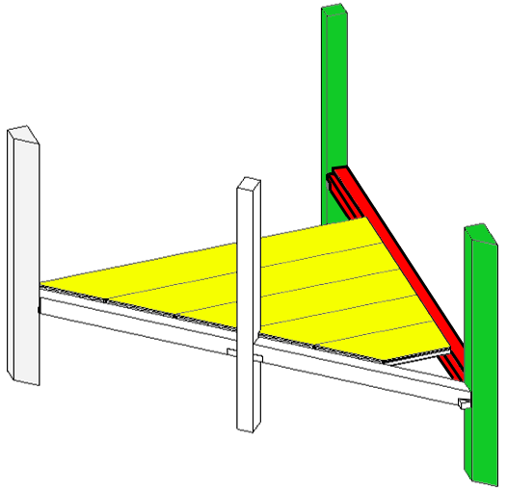
Standard vocabulary (1)
rvt:Column
rvt:Column
rdf:type
rdf:type
COL_001
COL_002
rvt:hasCorbel
rvt:hasCorbel
rdf:type
COR_001
COR_002
rdf:type
rvt:Corbel
rvt:hasGirder
rvt:hasGirder
rvt:Corbel
GIR_001
rdf:type
rvt:Girder
rvt:hasSlab
SLAB_1
SLAB_2
SLAB_3
SLAB_4
SLAB_5
rdf:type
rvt:Slab
G. Costa, P. Pauwels. Building product suggestions for a BIM model based on rule sets and a semantic reasoning engine. Proceedings of the 32rd international CIB W78 conference. 2015. p.98-107.

Slide 40
Choose your ontologies wisely

Slide 41
Outline
Information exchange and the AEC industry
LBD in practice!
Some technical basics
Scaling up the graph
Exercises!

Slide 42
Thank you
Pieter Pauwels
pipauwel.pauwels@ugent.be

